Slide 1
RESEARCH DESIGNS
Notes:
This chapter introduces the major descriptors and types of research design.

Slide 2
Learning Objectives
6-<number>
Understand . . .
The basic stages of research design.
The major descriptors of research design.
The major types of research designs.
The relationships that exist between variables in research design and the steps for evaluating those relationships.

Slide 3

What Is Research Design?
6-<number>
Blueprint
Plan
Guide
Framework
Notes:
There are many definitions of research design. Research design is the blueprint for fulfilling research objectives and answering questions. Its essentials include 1) an activity and time-based plan, 2) a plan based on the research questions, 3) a guide for selecting sources and types of information, 4) a framework for specifying the relationships among the study’s variables, and 5) a procedural outline for every research activity.

Slide 4
Definition
6-<number>
Research design is advance planning of the methods to be adopted for collecting the relevant data and the techniques to be used in their analysis.
It provides the glue that holds the research project together.
It is the structure that shows what all the different parts of the research are, how they connect with each other, what will be done in the research and in what sequence. Keith (2005)
How all the major parts of a research project work together to try to address the central research questions being investigated.
It’s takes into account the objective of the research and the availability of staff, time and money.

Slide 5
Def. cnt’d
6-<number>
Research design is the conceptual structure within which research is conducted;
It constitutes the blueprint for the collection, measurement and analysis of data. Kothari (2004) [i]
It is the arrangement of conditions for collection and analysis of data in a manner that aims to combine relevance to the research purpose with economy in procedure. Claire 1962[ii]
Research design therefore is the road map that defines a research from the moment the hypothesis is written to the final point at which data will be analyzed.

Slide 6
Key components of a research design
6-<number>
a clear statement of the research problem
procedures and techniques to be used for gathering information
the population to be studied
methods to be used in processing and analyzing data as:

Slide 7
Classification of research design
6-<number>
Four Classifications
The sampling design – this deals with method of selecting items to be observed for the given study.
The observational design – this relates to the conditions under which the observations are made
The statistical design – this deals with the question of numbers – how many items are to be observed and how the data gathered will be analyzed
The operational design – this deals with techniques by which the procedures stated in the above three designs will be carried out.

Slide 8
Why a research design
6-<number>
Enables researcher have a well laid out plan of the various components of the study
It facilitates the smooth implementation of the various research operations
Makes research as efficient as possible
Enables researcher obtain maximum information with minimum expenditure in terms of time, effort and money.
Helps the researcher organize ideas in a form which easily indicates flaws and inadequacies that need addressing thus helping researcher meet objectives

Slide 9
Features of a research design
6-<number>
A good design serves the purpose or objective of the research problem and is in line with the nature of the problem to be studied.
It minimizes bias and maximizes the reliability of data collected and analyzed. (Kothari 2004).
A good design is also dependent on the type of research to be done. For example in many investigations it is one with the smallest experimental data error.
it is one that yields maximal information and provides an opportunity for considering many different aspects of a problem.
Note: a good design in one type of research problem may be quite inappropriate in another.

Slide 10
Factors to consider in choosing a research design
6-<number>
The means of obtaining information
Availability and skills of the researcher and their staff
Objective of the problem to be studied
Nature of the problem
Availability of time and money for the research.

Slide 11
Important concepts in research design
6-<number>
1.Dependent and independent variables.
A variable is a concept which can take different quantitative value. If a variable depends on another or is a consequence of the other variable, it is called a dependent variable.
  E.g If the weight of a child depends on his age, then height is a dependent of age, and age is then the independent variable.
2.Extraneous variable.
These are independent variables that are not related to the purpose of the study but which affect the dependent variable.
  E.g- if a researcher wants to test the relationship between age of children and their weight above, the food they eat may also affect their weight but since food is not related to the study being undertaken, it is termed as an extraneous variable.

Slide 12
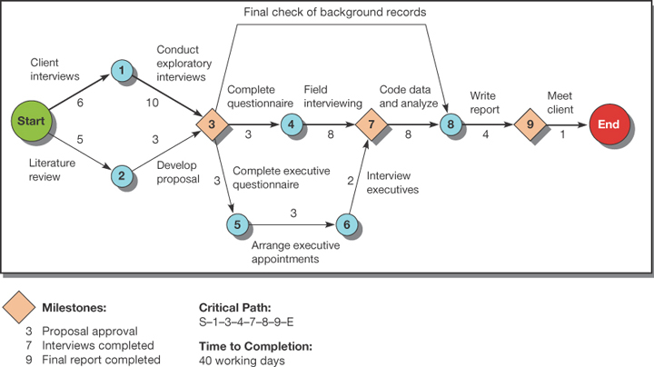
What Tools Are Used in
Designing Research?
6-<number>
Notes:
Exhibit 6-2 provides one project management tool: critical path method (CPM). In a CPM chart:
The nodes represent major milestones.
The arrows suggest the work needed to get to the milestones.
More than one arrow pointing to a node indicates all those tasks must be completed before the milestone has been met.
Usually a number is placed along the arrow showing the number of days or weeks required for that task to be completed.
The pathway from start to end that takes the longest time to complete is called the critical path.

Slide 13
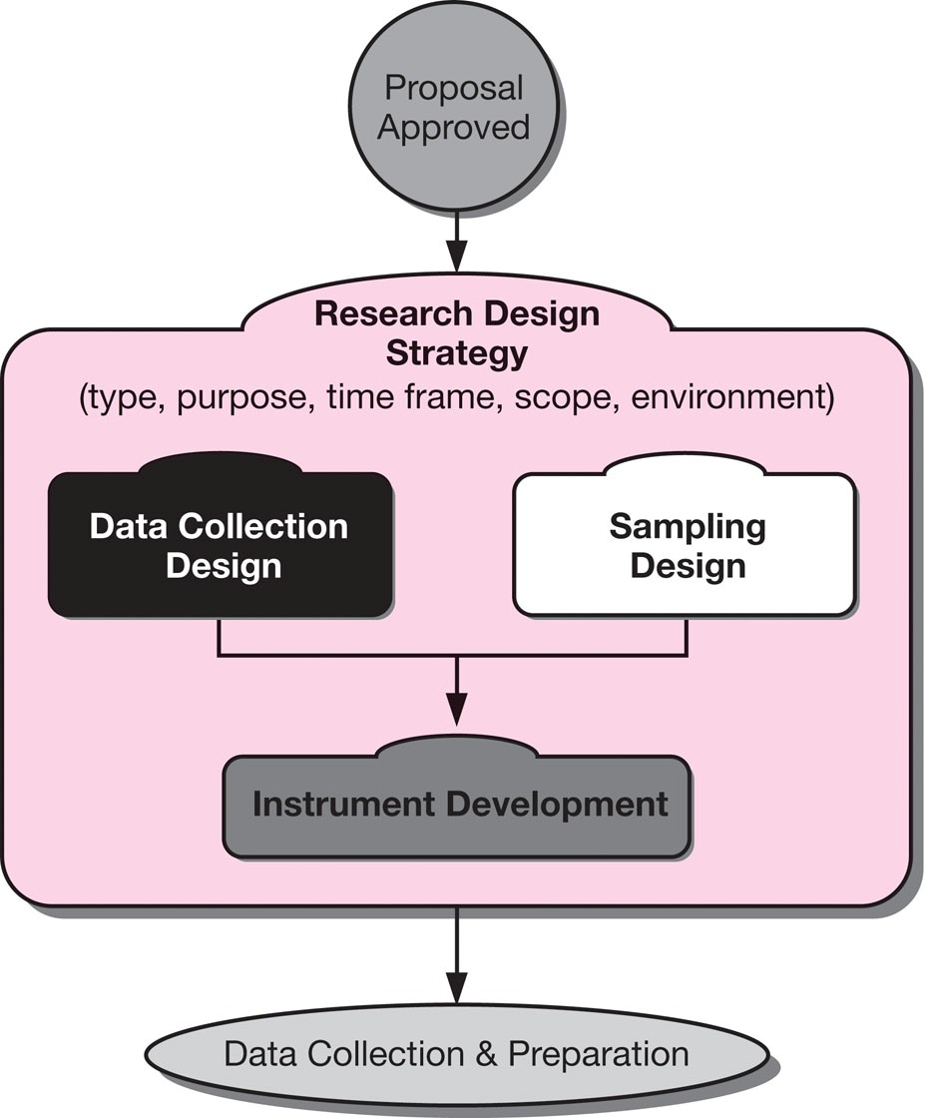
Design in the Research Process
6-<number>
Notes:
Exhibit 6-1 illustrates design in the research process and highlights the topics covered by the term research design. Subsequent chapters will provide more detailed coverage of the research design topics.

Slide 14
Descriptors of Research Design
6-<number>
Question Crystallization
Perceptual Awareness
Data Collection Method
Descriptors
Purpose of
Study
Experimental Effects
Research Environment
Time Dimension
Topical Scope
Notes:
Exhibit 6-3 information is presented here in a discussion format.
The degree to which the research question has been crystallized
Exploratory study
Formal study
The method of data collection
Monitoring
Communication Study
The power of the researcher to produce effects in the variables under study
Experimental
Ex post facto
The purpose of the study
Reporting
Descriptive
Causal-Explanatory
Causal-Predictive
The time dimension
Cross-sectional
Longitudinal
The topical scope—breadth and depth—of the study
Case
Statistical study
The research environment
Field setting
Laboratory research
Simulation
The participants’ perceptional awareness of the research activity
Actual routine
Modified routine

Slide 15
Degree of Question Crystallization
6-<number>
Exploratory Study
Loose structure
Expand understanding
Provide insight
Develop hypotheses
Formal Study
Precise procedures
Begins with hypotheses
Answers research questions
Notes:
The degree to which the research question has been crystallized or structured is the first descriptor of research design. There are two options.
Exploratory studies are used when the research question is still fluid or undetermined. The goal of exploration is to develop hypotheses or questions for future research.
Formal studies are used when the research question is fully developed and there are hypotheses to be examined.

Slide 16
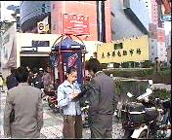
Desired Outcomes of Exploratory Studies
6-<number>
Established range and scope of possible management decisions
Established major dimensions of research task
Defined a set of subsidiary questions that can guide research design
Notes:
An exploratory study is finished when the researchers have achieved the objectives listed in this and the next slide.

Slide 17
Desired Outcomes of
Exploratory Studies (cont.)
6-<number>
Developed hypotheses about possible causes of management dilemma
Learned which hypotheses can be safely ignored
Concluded additional research is not needed or not feasible

Slide 18

Commonly Used Exploratory Techniques
6-<number>
Secondary Data Analysis
Experience Surveys
Focus Groups
Notes:
While there are several types of exploratory techniques possible these are the three techniques with the widest applications for business researchers.
Secondary data analysis is also called a literature search. Within secondary data exploration, researchers should start first with an organization’s own data archives. The second source of secondary data is published documents prepared by authors outside the sponsor organization.
Experience surveys are semistructured or unstructured interviews with experts on a topic or a dimension of a topic.
Focus groups are discussions on a topic involving a small group of participants led by a trained moderator.

Slide 19

6-<number>
Face-to-face interaction—one of the best ways to learn from participants.
Notes:
This ad for Delve, a marketing research firm, points out the importance of primary data.

Slide 20
Experience Surveys
6-<number>
What is being done?
What has been tried in the past with or without success?
How have things changed?
Who is involved in the decisions?
What problem areas can be seen?
Whom can we count on to assist or participate in the research?
Notes:
Experience surveys are sometimes called expert interviews or key informant surveys. Even though the term survey is in the name, it is not a closed-ended, structured survey. Rather, experience surveys are interviews designed to extract as much information as possible from the expert’s knowledge. Broad questions guide the discussion. Several questions that could be used in an experience survey are listed in the slide.
Some examples of groups who might be identified for an experience survey include potential car buyers, dealer sales representatives, advertising columnists, and automotive industry analysts.

Slide 21
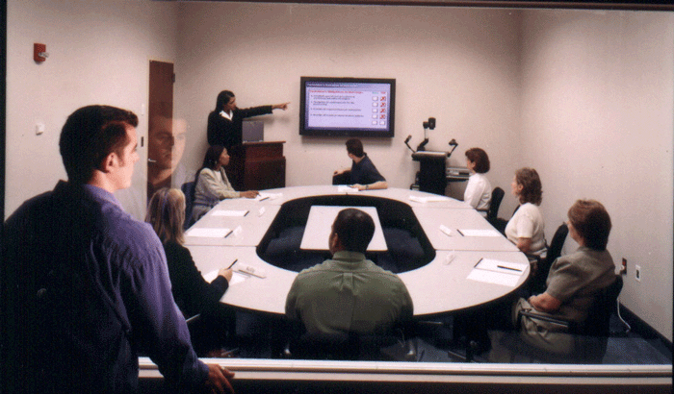
Focus Groups
6-<number>
Group discussion
6-10 participants
Moderator-led
90 minutes-2 hours
Notes:
Focus groups are widely used in business research. They are led by a trained moderator and typically include 6-10 participants. Mini-focus groups with just 3 people are increasingly common. The facilitator uses group dynamics principles to focus or guide the group in an exchange of ideas, feelings, and experiences on a specific topic.
Focus groups can take place in a variety of settings, but many take place in a focus group room equipped with one-way window and recording devices.

Slide 22
Descriptors of Research Design
6-<number>
Question Crystallization
Perceptual Awareness
Data Collection Method
Descriptors
Purpose of
Study
Experimental Effects
Research Environment
Time Dimension
Topical Scope
Notes:
Second element of Exhibit 6-3.

Slide 23


Data Collection Method
6-<number>
Monitoring
Communication
Notes:
Method of data collection distinguishes between monitoring and communication processes. Monitoring processes are studies in which the researcher inspects the activities of a participant or the nature of some material without eliciting responses from the participant. Examples of monitoring include traffic counts, library searches, and counting cars in a parking lot.
In a communication study, the researcher questions the participants and then collects their responses by personal or impersonal means.The collected data may result from 1) telephone or interview conversations, 2) self-administered or self-reported instruments sent through the mail, dropped-off in convenient locations, or transmitted electronically, 3) instruments presented before and/or after a treatment or stimulus condition in an experiment.

Slide 24
Descriptors of Research Design
6-<number>
Question Crystallization
Perceptual Awareness
Data Collection Method
Descriptors
Purpose of
Study
Experimental Effects
Research Environment
Time Dimension
Topical Scope
Notes:
(Exhibit 6-3 continued)
The degree to which the research question has been crystallized
Exploratory study
Formal study
The method of data collection
Monitoring
Communication Study
The power of the researcher to produce effects in the variables under study
Experimental
Ex post facto
The purpose of the study
Reporting
Descriptive
Causal-Explanatory
Causal-Predictive
The time dimension
Cross-sectional
Longitudinal
The topical scope—breadth and depth—of the study
Case
Statistical study
The research environment
Field setting
Laboratory research
Simulation
The participants’ perceptional awareness of the research activity
Actual routine
Modified routine

Slide 25

The Time Dimension
6-<number>
Cross-sectional
Longitudinal
Notes:
Cross-sectional studies are studies conducted only once. They seek to reveal a snapshot at one point in time. Longitudinal studies include repeated measures over an extended period of time. Therefore, longitudinal studies can track changes over time. Despite this advantage, longitudinal studies are expensive and time-intensive.

Slide 26
Descriptors of Research Design
6-<number>
Question Crystallization
Perceptual Awareness
Data Collection Method
Descriptors
Purpose of
Study
Experimental Effects
Research Environment
Time Dimension
Topical Scope
Notes:
The degree to which the research question has been crystallized
Exploratory study
Formal study
The method of data collection
Monitoring
Communication Study
The power of the researcher to produce effects in the variables under study
Experimental
Ex post facto
The purpose of the study
Reporting
Descriptive
Causal-Explanatory
Causal-Predictive
The time dimension
Cross-sectional
Longitudinal
The topical scope—breadth and depth—of the study
Case
Statistical study
The research environment
Field setting
Laboratory research
Simulation
The participants’ perceptional awareness of the research activity
Actual routine
Modified routine

Slide 27
The Topical Scope
6-<number>
Statistical Study
Breadth
Population inferences
Quantitative
Generalizable findings
Case Study
Depth
Detail
Qualitative
Multiple sources of information
Notes:
The topical scope refers to the breadth (what properties will be measured) and depth (at what level will the properties be measured) of the study in question.
A statistical study is designed for breadth rather than depth. It attempts to capture a population’s characteristics by making inferences from a sample’s characteristics and then testing resulting hypotheses.
A case study places more emphasis on full contextual analysis of a few events or conditions and their interrelations. Case studies rely on qualitative data and emphasize the use of results for insight into problem-solving, evaluation, and strategy.
While case studies are not considered “scientific,” they do play an important role in challenging theory, providing new hypotheses, and offering new ideas on constructs.

Slide 28
Descriptors of Research Design
6-<number>
Question Crystallization
Perceptual Awareness
Data Collection Method
Descriptors
Purpose of
Study
Experimental Effects
Research Environment
Time Dimension
Topical Scope
Notes:
The degree to which the research question has been crystallized
Exploratory study
Formal study
The method of data collection
Monitoring
Communication Study
The power of the researcher to produce effects in the variables under study
Experimental
Ex post facto
The purpose of the study
Reporting
Descriptive
Causal-Explanatory
Causal-Predictive
The time dimension
Cross-sectional
Longitudinal
The topical scope—breadth and depth—of the study
Case
Statistical study
The research environment
Field setting
Laboratory research
Simulation
The participants’ perceptional awareness of the research activity
Actual routine
Modified routine

Slide 29
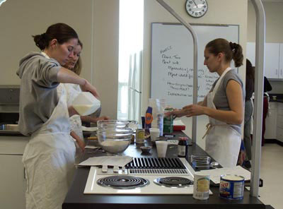
The Research Environment
6-<number>
Field conditions
Lab conditions
Simulations
Notes:
Designs also differ as to whether they occur under actual environmental conditions. Field conditions mean that the research occurs in the actual environmental conditions where the dependent variable occurs. Under laboratory conditions, the studies occur under conditions that do not simulate actual environmental conditions. In a simulation, the study environment seeks to replicate the natural environment in a controlled situation. For instance, a lab set up as a kitchen would serve as a simulation of a consumer’s own kitchen.

Slide 30
Descriptors of Research Design
6-<number>
Question Crystallization
Perceptual Awareness
Data Collection Method
Descriptors
Purpose of
Study
Experimental Effects
Research Environment
Time Dimension
Topical Scope
Notes:
The degree to which the research question has been crystallized
Exploratory study
Formal study
The method of data collection
Monitoring
Communication Study
The power of the researcher to produce effects in the variables under study
Experimental
Ex post facto
The purpose of the study
Reporting
Descriptive
Causal-Explanatory
Causal-Predictive
The time dimension
Cross-sectional
Longitudinal
The topical scope—breadth and depth—of the study
Case
Statistical study
The research environment
Field setting
Laboratory research
Simulation
The participants’ perceptional awareness of the research activity
Actual routine
Modified routine

Slide 31

Purpose of the Study
6-<number>
Reporting
Descriptive
Casual -Explanatory
Causal -Predictive

Slide 32
Descriptive Studies
6-<number>
Who?
How much?
What?
When?
Where?
Notes:
The purpose of the study asks whether the research is concerned with describing the population’s characteristics or with trying to explain the relationships among variables. Descriptive studies discover the answers to the questions who, what, when, where, or how much.

Slide 33

Descriptive Studies
6-<number>
Descriptions of population characteristics
Estimates of frequency of characteristics
Discovery of associations among variables
Notes:
In contrast to exploratory studies, more formalized studies are typically structured with clearly stated hypotheses or investigative questions. Formal studies serve a variety of research objectives such as those listed in the slide.
The third objective, discovery of variable associations, is sometimes labeled a correlational study, which is a subset of descriptive studies. Correlation is the relationship by which two or more variables change together, such that systematic changes in one accompany systematic changes in the other.

Slide 34
Descriptors of Research Design
6-<number>
Question Crystallization
Perceptual Awareness
Data Collection Method
Descriptors
Purpose of
Study
Experimental Effects
Research Environment
Time Dimension
Topical Scope
Notes:
The degree to which the research question has been crystallized
Exploratory study
Formal study
The method of data collection
Monitoring
Communication Study
The power of the researcher to produce effects in the variables under study
Experimental
Ex post facto
The purpose of the study
Reporting
Descriptive
Causal-Explanatory
Causal-Predictive
The time dimension
Cross-sectional
Longitudinal
The topical scope—breadth and depth—of the study
Case
Statistical study
The research environment
Field setting
Laboratory research
Simulation
The participants’ perceptional awareness of the research activity
Actual routine
Modified routine

Slide 35
Experimental Effects
6-<number>
Ex Post Facto Study
After-the-fact report on what happened to the measured variable
Experiment
Study involving the manipulation or control of one or more variables to determine the effect on another variable
Notes:
Causal studies are differentiated by their ability to control and manipulate variables.
Causal studies may be experiments or ex post facto studies.
Experiments are studies involving the manipulation of one or more variables to determine the effect on another variable. For example, direct marketers can use split tests on mailings to test which mailing resulted in the highest response rate.
Ex post facto designs are evaluations made after-the-fact based on measured variables.

Slide 36
Ex Post Facto Design
6-<number>
 | Fishing Club Member |  | Non-Fishing-Club Member
Age | High Absentee | Low Absentee | High Absentee | Low Absentee
Under 30 years | 36 | 6 | 30 | 48
30 to 45 | 4 | 4 | 35 | 117
45 and over | 0 | 0 | 5 | 115
Notes:
This shows employment absenteeism results by age of head of household and club membership. This is an example of results that could come from an ex post facto study. Instead of manipulating variables or controlling exposure to an experimental variable to judge absenteeism, we study subjects who have been exposed to the independent factor and those who have not.

Slide 37
Causation and Experimental Design
6-<number>
Control/
Matching
Random
Assignment
Notes:
To be convincing, inferences from experimental designs must meet two other requirements, in addition to those covered on the last slide. The first is control. Control means that all factors but the IV are held constant and are not confounded with another variable that is not part of the study. The second requirement is that each person in the study must have an equal chance for exposure to each level of the independent variable. This is accomplished through random assignment of subjects to groups.
Random assignment uses a randomized list of participants for assigning participants to experimental and control groups.
The control group is the group of participants that is measured but not exposed to the independent variable being studied.
Control can also be accomplished using matching. Matching is an equalizing process for assigning participants to experimental and control groups. In this case, we ensure that all groups are essentially equal with respect to the variable of influence.

Slide 38
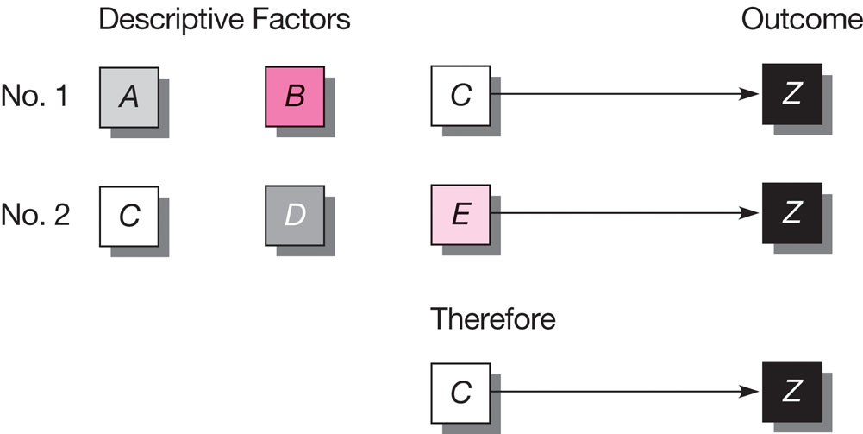
Mills Method of Agreement
6-<number>
Notes:
Exhibit 6-4

Slide 39
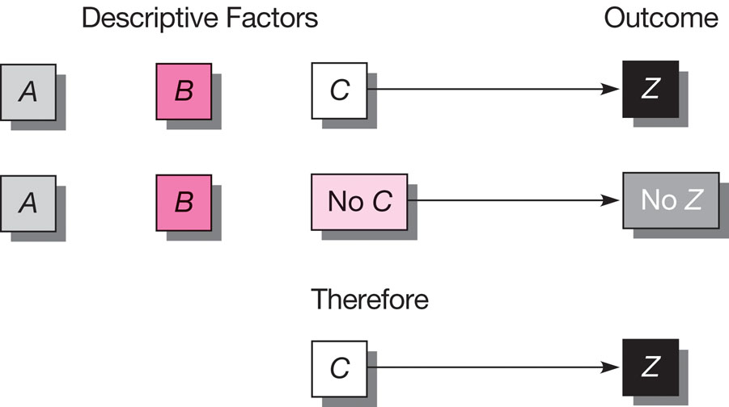
Mills Method of Difference
6-<number>
Notes:
Exhibit 6-5

Slide 40
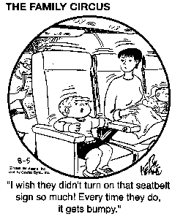
Causal Studies
6-<number>
Symmetrical
Reciprocal
Asymmetrical
Notes:
People without scientific training may think that a correlation is causation. However, just because two things change together does not imply a cause-and-effect relationship. The essential element of causation is that some external factor produces a change in the dependent variable: A produces B. Empirically, we never demonstrate causality with certainty because we do not prove causal linkages deductively. Empirical research conclusions are based on inferences or inductive conclusions. These conclusions are probability statements, based on what we observe and measure and what we conclude is likely to happen.
There are three possible relationships that can occur between two variables. These are named in the slide. A symmetrical relationship is one in which two variables vary together but we assume the changes in neither variables are due to changes in the other.
A reciprocal relationship exists when two variables mutually influence or reinforce each other.
With asymmetrical relationships, we postulate that changes in one variable (independent variable) are responsible for changes in another (dependent variable). Exhibit 8-3 describes the four types of asymmetrical relationships and is provided on the next slide.

Slide 41
Understanding Casual Relationships
6-<number>
Property
Behavior
Response
Disposition
Stimulus
Notes:
Exhibit 8-3 details…relationship but students need to understand the foundations:
A stimulus is an event or force (e.g., drop in temperature, crash of stock market, product recall, or explosion in factory).
A response is a decision or reaction.
A property is an enduring characteristic of a subject that does not depend on circumstances for its activation (e.g., age, gender, family status, religious affiliation, ethnic group, or physical condition).
A disposition is a tendency to respond in a certain way under certain circumstances (e.g., attitudes, opinions, habits, values, and drives).
A behavior is an action (e.g., consumption habits, work performance, interpersonal acts, and other kinds of performance).

Slide 42
Asymmetrical Casual Relationships
6-<number>
Stimulus-Response
Property-
Behavior
Property-
Disposition
Disposition-Behavior
Notes:
Exhibit 8-3 details the four types of asymmetrical causal relationships.
A stimulus-response relationship refers to an event or change that results in a response from some object. An example is a change in commission structure that leads to a higher level of agent sales.
A property-disposition relationship refers to an existing property that causes a disposition. An example is the relationship between age and attitudes about saving.
A disposition-behavior relationship refers to a disposition that causes a specific behavior. An example is the relationship between moral values and shoplifting.
A property-behavior relationship refers to an existing property that causes a specific behavior. An example is the relationship between age and sports participation.

Slide 43
Exhibit 6-6 Types of Asymmetrical Causal Relationships
6-<number>
Relationship Type | Nature of Relationship | Examples
Stimulus-response | An event or change results in a response from some object. | A change in work rules leads to a higher level of worker output. A change in government economic policy restricts corporate financial decisions. A price increase results in fewer unit sales.
Property-disposition | An existing property causes a disposition. | Age and attitudes about saving. Gender attitudes toward social issues. Social class and opinions about taxation.
Disposition-behavior | A disposition causes a specific behavior. | Opinions about a brand and its purchase. Job satisfaction and work output. Moral values and tax cheating.
Property-behavior | An existing property causes a specific behavior. | Stage of the family life cycle and purchases of furniture. Social class and family savings patterns. Age and sports participation.

Slide 44

Evidence of Causality
6-<number>
Covariation between
A and B
Time order of events
No other possible
causes of B
Notes:
When testing causal hypotheses, we seek three types of evidence:
Covariation between A and B.
Do we find that A and B occur together in the way hypothesized?
When A does not occur, is there also an absence of B?
When there is more or less of A, does one also find more or less of B?
2. Time order of events moving in the hypothesized direction.
Does A occur before B?
3. No other possible causes of B.
Can one determine that C, D, and E do not covary with B in a way that suggests possible causal connections?

Slide 45
Descriptors of Research Design
6-<number>
Question Crystallization
Perceptual Awareness
Data Collection Method
Descriptors
Purpose of
Study
Experimental Effects
Research Environment
Time Dimension
Topical Scope

Slide 46

Participants’ Perceptional Awareness
6-<number>
No deviation perceived
Deviations perceived
as unrelated
Deviations perceived as
researcher-induced
Notes:
The usefulness of a research design is reduced when people in a disguised study perceive that research is being conducted. Participants’ perceptions can influence the outcomes of research. This was first discovered in the 1920s when researchers at the Hawthorne plant of the Western Electric Company found that participants reacted favorably to receiving attention.
There are three levels of perception to consider and these are highlighted in the slide.
Mystery shopping sometimes provides an example of the third level of perception. Mystery shopping involves individuals who pose as customers and visit retail or service organizations to observe and measure specific behaviors or circumstances. If a retail sales associate knows that she is being observed and evaluated, she is likely to modify her performance.

Slide 47
Descriptors of Research Design
6-<number>
Category | Options
The degree to which the research question has been crystallized | Exploratory study Formal study
The method of data collection | Monitoring Communication Study
The power of the researcher to produce effects in the variables under study | Experimental Ex post facto
The purpose of the study | Reporting Descriptive Causal-Explanatory Causal-Predictive
The time dimension | Cross-sectional Longitudinal
The topical scope—breadth and depth—of the study | Case Statistical study
The research environment | Field setting Laboratory research Simulation
The participants’ perceptional awareness of the research activity | Actual routine Modified routine
Notes:
Exhibit 6-3 organizes research design into eight categories. This slide is offered as a recap of the issues discussed.

Slide 48
Key Terms
6-<number>
Asymmetrical relationship
Case study
Causal study
Causation
Children’s panels
Communication study
Control
Control group
Correlation
Cross-sectional study
Descriptive study
Ethnographic research
Ex post facto design
Experience
Experiment
Exploratory study
Field conditions
Focus group
Formal study
Individual depth interview
Intranet

Slide 49
Key Terms (cont.)
6-<number>
Laboratory conditions
Longitudinal study
Matching
Monitoring
Primary data
Qualitative techniques
Random assignment
Reciprocal relationship
Research design
Secondary data
Simulation
Statistical study
Symmetrical relationship

